Slide 1

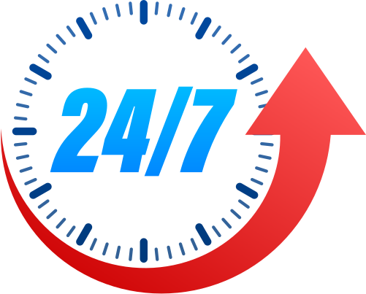




Project Green :
“Making commuinity safer and cleaner”
Presented by:
Team AMD-FWU
Team and Roles:
Adarsh Joshi: Project Manager
Anil Chandra Giri: FrontEnd Developer
Dinesh Pd. Joshi: BackEnd Developer
Mukesh Pant: Database Manager

Slide 2


Problems In Our Community
Pollution Management
Not well-managed Wastage and its report
Reaction Time and Process
Less Knowledge Of wastage management
2. Disaster Management
Busyness
old disaster preparedness and response mechanism

Slide 3

Project Green :
Community Oriented and User Friendly
A digitalized solution for wastage and Disaster Management
Digital Medium between Community and Local Authorities
Multiple Feature under a single platform

Slide 4


Features and SDGs Alignment :
AI chat bot & C.F.C
Pollution Tracker
Disaster Alert System
Allows to calculate Carbon Emmision
acts as a complete resource for pollution, disaster management, climate change, and environmental research.
Reporting real-time pollution data
Create awareness regading pollution in certain area
Creates Alert to Multiple Authorities at a single click
SDG Alignment
SDG Alignment
SDG Alignment
Climate Action and Good health
Sustainable Communities
Good Health and Well Being
Smart Cities and Innovation
Peace
Quality Learning

Slide 5






Technology Stack
Front End
BackEnd
Database & AI

Slide 6
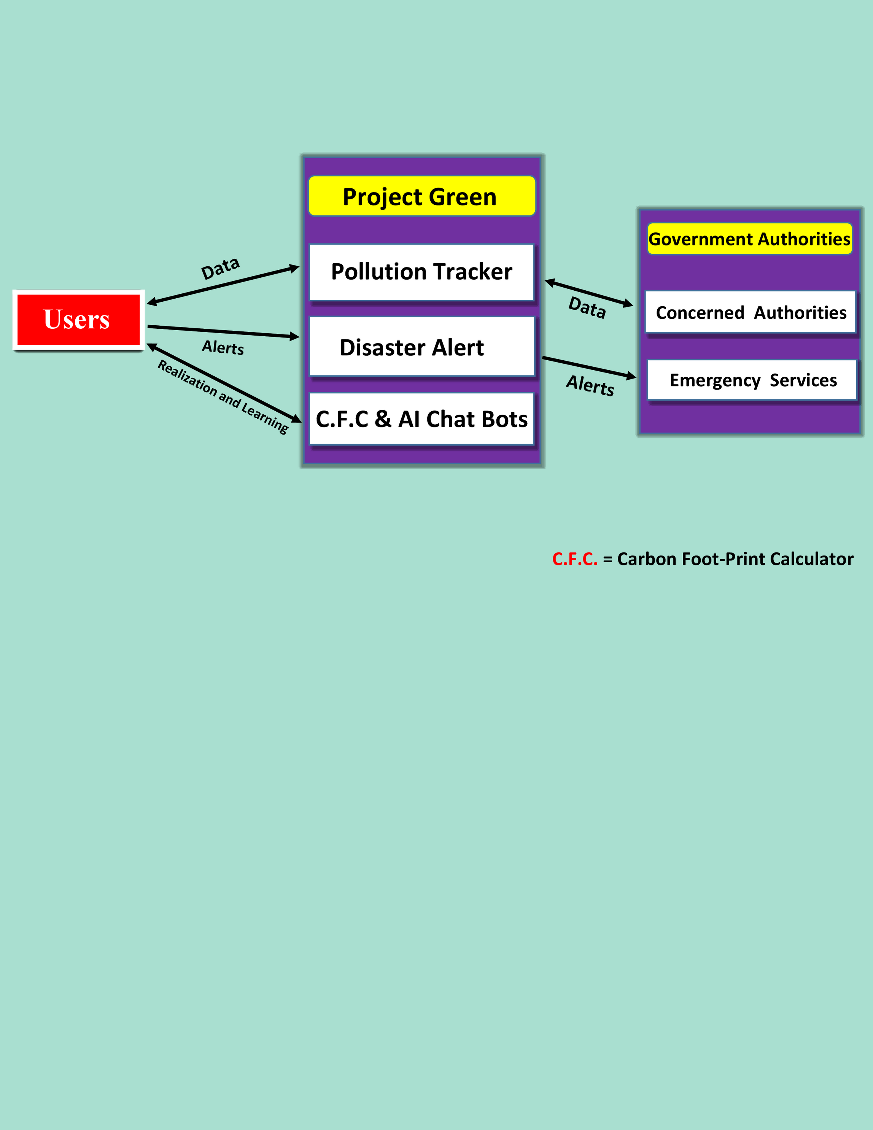
Working Mechanism :

Slide 7
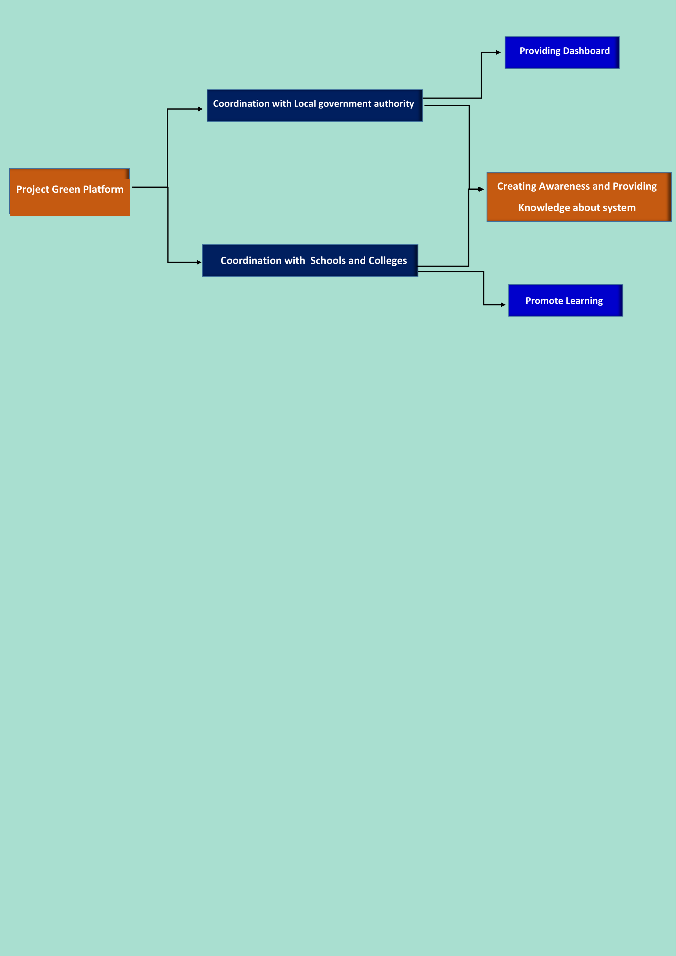
Implementation :
Step-1
Step-2

Slide 8
The main challenges identified and their solution :
Internet Access
User Engagement
fake alerts
Data Management
Resource Constraints
Solution
Solution
Solution
providing offline alert services
consulting with professionals
providing product at minimum cost thinking about Data Privacy , Security and Accuracy.
reward system
multilingual support
awareness program
login system

Slide 9
Budget & Revenue
Remember that building a sustainable budget and revenue model for a social service-based project like Project Green takes time and persistence.
Budget
Revenue
Research & Development
Community Engagement
Scaling and Expansion
Revenue from pollution tracking
Grants and Donation
Corporate Sponsorships & partnership

Slide 10





Why Project Green?
Project Green will be your super-efficient emergency buddy.
It's like a superhero that's always ready to help and never too busy.
When you report through us, it's like turning on a spotlight
Transparency of information in our platform will encourage authorities
for their best outcome
CFC will help you to know your Carbon Emission Rate
for environmental consciousness.
Project Green's Generative AI chatbot is your friendly pollution and disaster tutor.
I

Slide 11
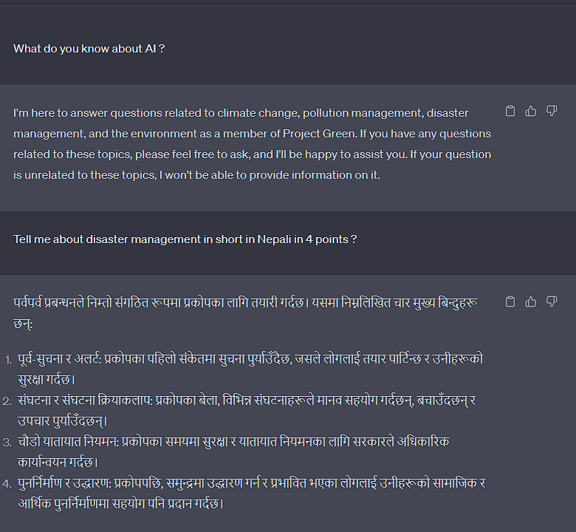
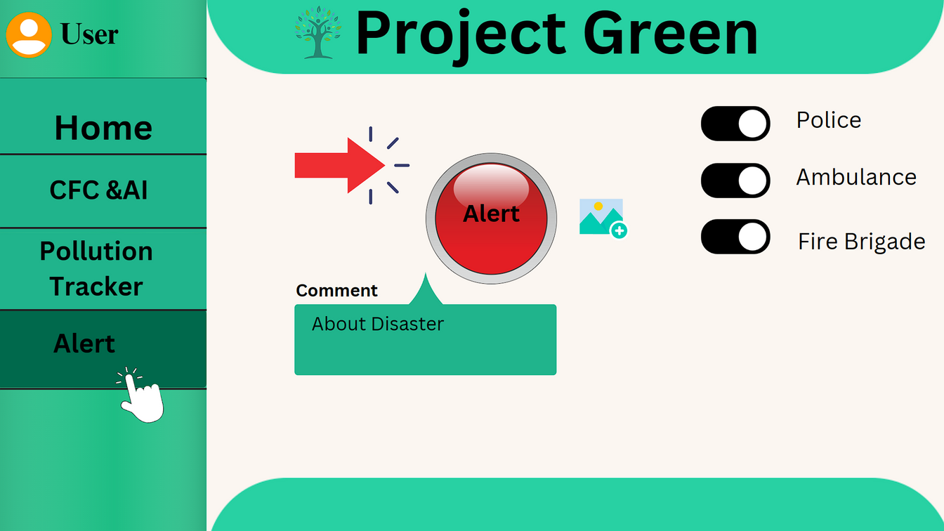
Sample Prototype
Alert Button sample
AI ChatBot response

Slide 12

"Project Green" holds the promise of creating a cleaner, safer, and more sustainable community. With community support and collaboration, we can achieve lasting positive change.
Thank you very much!
Questions & suggestions ?

